Slide 1
Qualitative Survey
Dirk Riehle, Univ. Erlangen
NYT C03
Licensed under CC BY 4.0 International

Slide 2
Agenda
Qualitative surveys
Qualitative vs. quantitative surveys
Purposive sampling
Data collection
Data analysis
Quality assurance

Slide 3
1. Qualitative Surveys

Slide 4
Qualitative Surveys
A survey is
The study of a population through observation of its members
A qualitative survey is a survey studying
Diversity (not distribution) in a population for theory building purposes
Qualitative surveys may be the simplest possible theory building methodology
The most common variant is the interview study

Slide 5
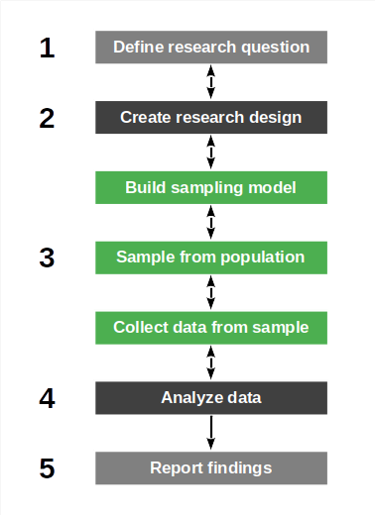
Qualitative Survey Process
The qualitative survey process consists of
Defining the research question
Designing the qualitative survey
Create research design
Build sampling model
Performing the qualitative survey
Sample purposefully
Collect data
Analyzing data
A common methodology for qualitative surveys is Jansen (2010)

Slide 6
Example QS Episodic Volunteer Retention (EVR) RQ [1]
How do open source projects retain episodic volunteers?
How do these practices relate to traditional retention practices?
Open source projects rely on free “volunteer” contributions
Some of these volunteers are habitual, some are episodic
[1] See Barcomb et al. (2020): Uncovering the periphery.

Slide 7
Qualitative Survey vs. Interview Study
Most qualitative surveys are interview studies

Slide 8
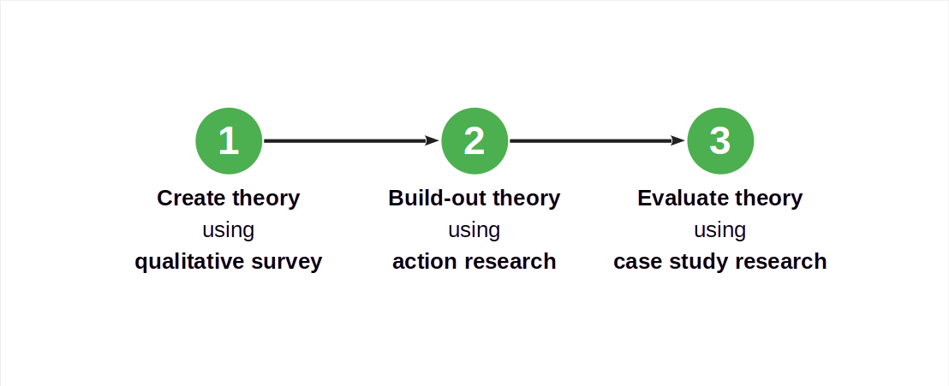
Qualitative Surveys in a Larger Research Design

Slide 9
2. Qualitative vs. Quantitative Surveys

Slide 10
Open vs. Pre-structured Qualitative Surveys
Jansen (2010) distinguishes between
Open (inductive) qualitative surveys (for theory building)
Pre-structured (deductive) qualitative surveys for measuring diversity
In addition to pre-structured surveys there
Hypothesis-testing quantitative surveys

Slide 11
Pre-Structured (Deductive) Qualitative Surveys
A pre-structured qualitative survey [1], according to Jansen (2010)
Quantitatively assesses diversity in a population using established categories
As such, this type of survey is descriptive and findings have to fit the mold
Which of a set of predefined characteristics exist in a given population?
[1] I have no idea why she calls an essentially quantitative survey a qualitative survey [DR]

Slide 12
Qualitative vs. Quantitative Surveys 1 / 2
A qualitative survey studies
Diversity (of variables) in a population where
A quantitative survey studies
Distribution (of variables) in a population where

Slide 13
Example of a Hypothesis-Testing Survey [1]
To what extent are the following six proposed theoretical constructs indicative of an episodic volunteers intention to remain a volunteer to a project?
Volunteering experience
Contributor benefit motivations
Psychological sense of community
Community commitment
Social norms
Satisfaction
These constructs were an outcome of the example qualitative survey research
[1] See Barcomb et al. (2019): Why do episodic volunteers stay?

Slide 14
Qualitative vs. Quantitative Surveys 2 / 2
Steps | Qualitative Survey | Descriptive Survey | Hypothesis-testing Survey
Study purpose | Diversity / insight | Distribution analysis | Hypothesis testing
Population sampling | Theoretical / purposive | (Stratified) Random | (Stratified) Random
Variable scales | Nominal or ordinal | Interval or ratio | Interval or ratio
Stopping criterion | Theoretical saturation | Statistical significance | Statistical significance
Results | Hypotheses | Descriptive statistics | Correlations

Slide 15
Example Qualitative vs. Hypothesis-Testing Survey Comparison
Steps | A qualitative survey of episodic volunteering | A hypothesis-testing survey of episodic volunteering practices
Study purpose | Understand retention practices for episodic volunteers | Testing relevance of constructs for intention to remain
Population sampling | Project leaders from diverse set of projects | Open questionnaire advertised (“convenience sampling”)
Variable scales | Categorical | Interval / distribution
Stopping criterion | Saturation of learning about new practices | Time and effort
Results | A set of retention practices | A (in)validation of practices

Slide 16
3. Purposive Sampling

Slide 17
Purposive Sampling
Sampling is
The selection of members (the sample) of a population
Purposive sampling is sampling in which the selection
Is purposeful for theory building
Theoretical sampling is a variant of purposive sampling
Used in grounded theory research

Slide 18
Sampling Model and Population
A sampling model
Is a model of the population designed to sample from
Focuses on the properties of relevance to the research question
The population is
The set of elements characterized by the sampling model

Slide 19
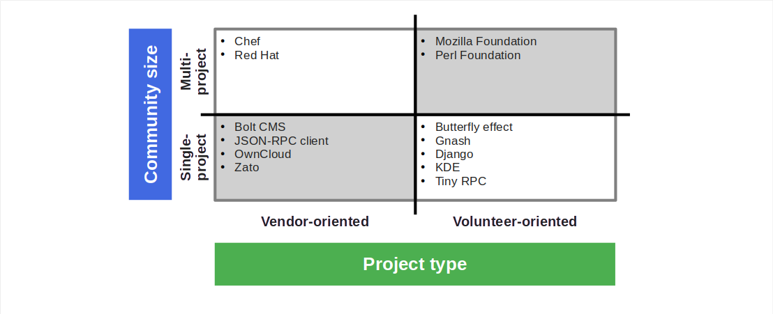
Example QS EVR Sampling Model with Sample

Slide 20
How to Build a Sampling Model?
The sampling model already incorporates assumptions (biases) about the domain
It should be derived from prior work, for example, a systematic literature review
In situations of high uncertainty, start with a small model and revise over time

Slide 21
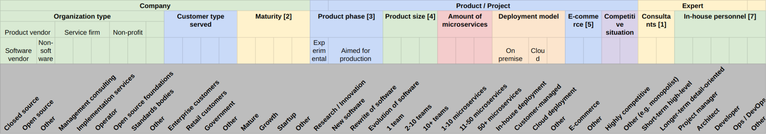
Example Microservice Integration Sampling Model
Interview study of domain experts on best practices of microservice integration
Population were experts of microservice architectures
Diversity sought out was captured by model

Slide 22
Purposive Sampling Strategies
Purposive sampling strategies
Typical case sampling
Chooses a common representative case
Critical case sampling
Chooses outlier cases for theoretical insight
Polar sampling
Chooses sets of elements based on opposing attributes

Slide 23
Sample Sizes
The initial sample should broadly cover the existing diversity
Grow sample (add more elements) as you work towards saturation
Heuristics for initial sample sizes [1]
Recommendations by other experts in the domain
Recommendations from qualitative methodologist
Prior knowledge about reaching saturation
[1] See Baltes & Ralph (2022): Sampling in software engineering research.
Notes:
Marshall, B., Cardon, P., Poddar, A., & Fontenot, R. (2013). Does sample size matter in qualitative research?: A review of qualitative interviews in IS research. Journal of computer information systems, 54(1), 11-22.
Onwuegbuzie, A. J., & Leech, N. L. “A call for qualitative power analyses,” Quality & Quantity, (41), 2007, 105-121.

Slide 24
Recommendations for Sample Sizes
Some recommendations by qualitative methodologists for
Grounded theory research
Creswell (2007): At least 20 to 30 interviewees
Denzin and Lincoln (2005): About 30 to 50 interviews
Morse (2000): About 20 to 30 interviewees
Case study research
Creswell (2007): Max. 4 or 5 cases and 3 to 5 interviewees per case
No rule-of-thumb beats theoretical saturation though
Notes:
Marshall, B., Cardon, P., Poddar, A., & Fontenot, R. (2013). Does sample size matter in qualitative research?: A review of qualitative interviews in IS research. Journal of computer information systems, 54(1), 11-22.
Creswell, J. W. Qualitative inquiry & research design: Choosing among five approaches (2nd ed.). Sage, Thousand Oaks, CA, 2007.
Denzin, N. K., & Lincoln Y. S. “The discipline and practice of qualitative research,” In N. K. Denzin & Y. S. Lincoln (Eds.), The Sage Handbook of Qualitative Research (3rd ed.), Sage, Thousand Oaks, CA, 2005, 1-32.
Morse, J. M. “Determining sample size,” Qualitative Health Research, (10:1), 2000, 3-5.
Yin, R. Case Study Research: Design and Methods (4th ed.). Sage, Thousand Oaks, CA, 2009.

Slide 25
4. Data Collection

Slide 26
Qualitative Surveys as Interview Studies
Types of interviews
Unstructured
Structured
Semi-structured
Types of interviewees
Individual person
Groups of people

Slide 27
Unstructured Interviews
Unstructured interviews
Have open-ended questions, are “in-depth interviews”
Allow order of questions, emphasis, and depth to vary by interview
Are managed and adapted in the situation by the interviewer
Do not impose any prior categorization on collected data

Slide 28
Structured Interviews
Fully structured interviews
Have a predetermined question set, with little room for variation
Have a predetermined order and no variation between interviewees
Contain closed questions (fixed set of answer choices)
Are created from an existing coding scheme for the responses
Aim to categorize behavior within pre-established categories
Structured interviews are not used in theory building
They are effectively a quantitative survey

Slide 29
Semi-Structured Interviews
Semi-structured interviews are
Interviews with both a structured and unstructured part
Theory building (unstructured part) tends to dominate
Structured part to add some statistical data to better understand the population

Slide 30
Why an Interview Study?
“Industry [1] is where the research data is.” [DR]
[1] Or just “practice”

Slide 31
Interview Study Process
For each selected interviewee
Prepare protocol
Setup protocol, prepare questions
Update questions if needed
Perform interview
Interview current interviewee
Capture and transcribe interview
Analyze results
Perform qualitative data analysis
Check saturation, iterate if necessary
Use and follow an established method [1]
[1] For example, DiCicco‐Bloom & Crabtree (2006): The qualitative research interview.

Slide 32
Prepare Protocol
Prepare protocol
Document all relevant meta-data, for example, interviewee name, etc.
Outline (if doing it for the first time) or amend process
Prepare questions [1]
What and how to ask based on research question
Structure questions into categories, have order
Usually start with some demographics
Go from the general to the specific
Have a closing, follow-up, thank you
[1] See Roberts (2022): Qualitative interview questions.

Slide 33
Perform Interview 1 / 3
Follow your interview guide (questions)
Introductory comments
Clarify purpose of interview
Ask for permission to record interview
Explain purpose of recording
Allow for off the record remarks
Inquire about use of quotes
Interview conversation
Record the spoken word (audio)
Take notes on non-verbal information
Prefer open-ended questions

Slide 34
Example QS EVR Interview Protocol
Guide for community managers
Introduction
Establish subject’s authority
Understand what the interview subject means by volunteering
What types of episodic volunteering are present
What does episodic volunteering look like
How are episodic volunteers managed
Which activities are best suited to episodic volunteers
Which activities are not suited to episodic volunteers
Conclusion
Guide for episodic volunteers
Introduction
Episodic volunteering pattern in a community
Motives and Intentions
What initially inspired you to volunteer
Do you intend to continue to volunteer
How do you make that decision
Experiences
Practices
Volunteering identity/behavior
Conclusion
Do you have additional insights

Slide 35
Perform Interview 2 / 3
Follow interview guide (questions) but do not be afraid to
Reorder questions
Rephrase, reiterate questions
Go off course if answers warrant it!
Be open-minded, avoid leading questions, etc.
Let the interviewee talk but pull them back to the topic if they digress

Slide 36
Perform Interview 3 / 3
After the interview
Transcribe the audio recording
Check the transcript manually
Correct the sentences if necessary
Delete off-the-record parts
Confirm transcription with interviewee

Slide 37
Other Data Sources / Primary Materials
Beyond interview studies
Existing documents / documentation
Workshop notes / transcripts
Participant observation
Outside observations
…

Slide 38
5. Data Analysis

Slide 39
Interview Study Process (Continued)
For each selected interviewee
Prepare protocol
Setup protocol, prepare questions
Updated questions if needed
Perform interview
Interview current interviewee
Capture and transcribe interview
Analyze results
Perform qualitative data analysis
Check saturation, iterate if necessary

Slide 40
Three Levels of Diversity Analysis
There are three levels (types) of analysis according to Jansen (2010)
Unidimensional description (of collected data)
Data → Object, Object → Dimensions, Dimensions → Categories
Multidimensional description
Concept-oriented and case-oriented description
Explanation
Qualitative data analysis

Slide 41
Comparison of Coding Strategies
The qualitative survey [1] | Thematic analysis [2] | Grounded theory [3]
– | Initial coding and collation | Open coding
Upward coding Downward coding | Searching for themes | Axial coding
– | Reviewing themes | Selective coding
[1] See Jansen (2010): The qualitative survey.
[2] See Braun & Clarke (2012): Thematic analysis.
[3] See Corbin & Strauss (2008): Grounded theory.

Slide 42
Until Saturation is Reached
Until saturation criterion tied to analysis method is reached

Slide 43
Example QS EVR Saturation Criterion
After 14 interviews (out of 20 in total) all codes were set

Slide 44
6. Quality Assurance

Slide 45
Quality Assurance
Quality assurance is tied to the individual research methods
Systematic literature review → sampling model and sampling
Qualitative data analysis → data analysis

Slide 46
Examples QS EVR Quality Assurance
First iteration
Two coders, with the second coder recoding the first coder’s work
Second iteration
Same procedure, with the second coder being a distributed coding team
In each iteration, the codebook was discussed and revised

Slide 47
Summary
Qualitative surveys
Qualitative vs. quantitative surveys
Purposive sampling
Data collection
Data analysis
Quality assurance

Slide 48
Thank you! Any questions?
dirk.riehle@fau.de – https://oss.cs.fau.de
dirk@riehle.org – https://dirkriehle.com – @dirkriehle

Slide 49
Legal Notices
License
Licensed under the CC BY 4.0 International license
Copyright
© 2012, 2023 Dirk Riehle, some rights reserved

